Slide 1
Scalars and Vectors
AS Level Physics
2016/5
Notes:
We live in a (at least) four-dimensional world governed by the passing of time and three space dimensions; up and down, left and right, and back and forth. We observe that there are some quantities and processes in our world that depend on the direction in which they occur, and there are some quantities that do not depend on direction.

Slide 2
1. Basic Concept
IRON
Scalars and Vectors
Notes:
For example, the volume of an object, the three-dimensional space that an object occupies, does not depend on direction. If we have a 5 cubic foot block of iron and we move it up and down and then left and right, we still have a 5 cubic foot block of iron.
On the other hand, the location, of an object does depend on direction. If we move the 1 cubic foot block 5 miles to the western north, the resulting location is very different than if we moved it 5 miles to the east.
Mathematicians and scientists call a quantity which depends on direction a vector quantity. A quantity which does not depend on direction is called a scalar quantity.

Slide 3
What are scalar quantities?
Definition:
A scalar is a physical quantity that has magnitude (size) only.
Examples:
Mass (kg), Volume (cm³), Energy (J)
S
Notes:
For example, a person buys a tub of margarine which is labelled with a mass of 500 g. The mass of the tub of margarine is a scalar quantity. It only needs one number to describe it, in this case, 500 g.
Examples of scalar quantities:
mass has only a value, no direction
electric charge has only a value, no direction

Slide 4
What are vector quantities?
Definition:
A vector is a physical quantity that has both a magnitude and a direction.
Example:
Force (N), Velocity (ms⁻¹), Acceleration (ms⁻²)
V
Notes:
For example, a car is travelling east along a freeway at 100 km·h⁻¹. What we have here is a vector called the velocity. The car is moving at 100 km·h⁻¹(this is the magnitude) and we know where it is going – east (this is the direction). These two quantities, the speed and direction of the car, (a magnitude and a direction) together form a vector we call velocity.
Examples of vector quantities:
force has a value and a direction. You push or pull something with some strength (magnitude) in a particular direction
weight has a value and a direction. Your weight is proportional to your mass (magnitude) and is always in the direction towards the centre of the earth.

Slide 5
Exercise 1
Finish Table 1.
Classify the following as vectors or scalars in table 1:
Length, Force, Direction, Height, Time, Speed, Temperature, Distance, Speed, Energy, Power, Work, Volume, Temperature, Mass, Displacement, Velocity, Acceleration, Weight, Area, Density, Momentum, Pressure…

Slide 6
Scalar Vs. Vector
Scalars |  | Vectors
Yes | Magnitude | Yes
No | Direction | Yes
A scalar has magnitude only. | Definition | A vector quantity has magnitude and direction.
Distance, Speed, Length, Area, Volume, Energy, Power, Work, Temperature, Pressure, Mass, Density, Height | Examples | Displacement, Velocity, Acceleration, Momentum, Force (e.g. Weight)
Only have to compare the magnitude | When comparing 2 values | Have to compare both the magnitude and the direction
Notes:
Vector quantities have two characteristics, a magnitude and a direction. Scalar quantities have only a magnitude.
When comparing two vector quantities of the same type, you have to compare both the magnitude and the direction.
For scalars, you only have to compare the magnitude.

Slide 7

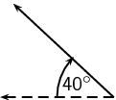
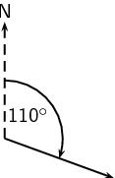
Vector Diagram
Each vector is represented by an arrow
Magnitude = Length of an arrow
Direction = Direction of an arrow
3 ways to represent direction: relative direction, compass directions, bearing
40° North of West
Drawing Tips:
The larger scale → the greater precision
Notes:
When doing any mathematical operation on a vector quantity (like adding, subtracting) you have to consider both the magnitude and the direction. This makes dealing with vector quantities a little more complicated than scalars. And that’s why we need help from a vector diagram.
Relative directions
The simplest way to show direction is with relative directions: to the left, to the right, forward, backward, up and down.
Compass directions
Another common method of expressing directions is to use the points of a compass: North, South, East, and West. If a vector does not point exactly in one of the compass directions, then we use an angle. For example, we can have a vector pointing 40° North of West.
Bearing
A further method of expressing direction is to use a bearing. A bearing is a direction relative to a fixed point. Given just an angle, the convention is to define the angle clockwise with respect to North. So, a vector with a direction of 110° has been rotated clockwise 110°> relative to North. A bearing is always written as a three digit number.

Slide 8
2. Add and Subtract Coplanar Vectors
Coplanar Vectors: Vectors lying in the same plane

Slide 9

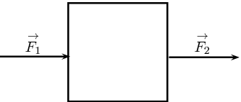

Vectors at a same direction - Add
Displacement
The two forces are in the same direction (i.e. forwards) and so the total force acting on the box is:
$$\overset{⃑}{F_{T}}=\overset{⃑}{F_{1}}+\overset{⃑}{F_{2}}$$
Notes:
We can represent vector addition graphically, based on the activity above. Draw the vector for the first two steps forward, followed by the vector with the next three steps forward.

Slide 10
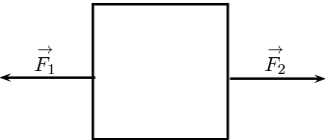

Vectors at a same direction - Subtract
Displacement:
In this case the two forces are in opposite directions.
If we define the direction pulling in as positive then the force exerting must be negative since it is in the opposite direction.
$$\overset{⃑}{F_{T}}=\overset{⃑}{F_{2}}+\overset{⃑}{F_{1}}$$
$$F_{T}=F_{2}+(−F_{1})$$
Notes:
We can represent vector addition graphically, based on the activity above. Draw the vector for the first two steps forward, followed by the vector with the next three steps forward.

Slide 11
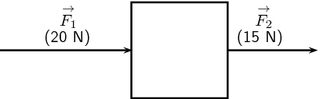
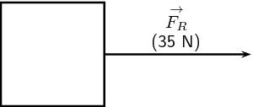
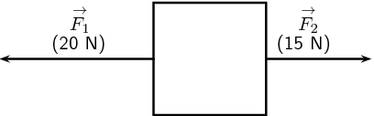
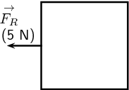


The resultant vector is the single vector whose effect is the same as the individual vectors acting together.
$$F_{R}=35N$$
$$F_{R}=−5N$$
Notes:
We can illustrate the concept of the resultant vector by considering our two situations in using forces to move the heavy box. In the first case (上面), you and your friend are applying forces in the same direction. The resultant force will be the sum of your two applied forces in that direction.
In the second case (下面), the forces are applied in opposite directions. The resultant vector will again be the sum of your two applied forces, however after choosing a positive direction, one force will be positive and the other will be negative and the sign of the resultant force will just depend on which direction you chose as positive.

Slide 12
3. Resolving Vectors

Slide 13





Trigonometric functions
$sinθ=\frac{V_{v}}{V}$
$cosθ=\frac{V_{h}}{V}$
$tanθ=\frac{V_{v}}{V_{h}}$
$$V$$
$$V_{v}$$
$$θ$$
$$V_{h}$$

Slide 14

Resolve into Vertical and Horizontal
Step 1: Draw a parallelogram.
Step 2: Measure the angle
Step 3:
$$V=V_{v}+V_{h}$$
$$V_{v}=Vsinθ$$
$$V_{h}=Vcosθ$$
$$V$$
$$V_{v}$$
$$θ$$
$$V_{h}$$

Slide 15







Vectors with different angles – Find $N_{T}$
Force
Step 1: Measure the angle and resolve forces into vertical and horizontal components
Step 2, horizontally and vertically…
$$N_{V}=N_{1v}sinθ+N_{2v}sinθ$$
$$N_{h}=N_{1v}cosθ+N_{2v}cosθ$$
Step 3, combine $N_{V}$+$N_{h}$ to form $N_{T}$
$$N_{T}=N_{1}+N_{2}$$
$$N_{T}$$
$$N_{2}$$
$$θ_{2}$$
$$N_{1}$$
$$θ_{1}$$

Slide 16




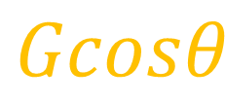
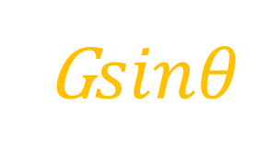

Example: What is the frictional force?
$$N$$
Step 1: Identify the frictional force
Step 2: Resolve the weight G into vertical and horizontal components
Step 3: Determine the acceleration of the box (a=0?)
Step 4: Equals the horizontal force to the frictional force, hence, get the answer: $Frictional Force,f=−Gsinθ$
$$f$$
G$sinθ$
$$Gcosθ$$
$$G$$
$$θ$$

Slide 17
Homework: All exercises provided
By next lesson

